Slide 1


Computer Networks
UNIT-III
Network & Transport Layer
By
Prof. Narasimha Swamy S
Department of Artificial Intelligence and Machine Learning
R V College of Engineering®, Bengaluru-59

Slide 2
Outline
Introduction
General Principles of Congestion Control
Congestion Prevention Policies
Congestion Control in Virtual-Circuit Subnets
Congestion Control in Datagram Subnets
Load Shedding
Jitter Control
Quality Of Service
Requirements
Techniques for Achieving Good Quality of Service Integrated Services
Differentiated Services

Slide 3
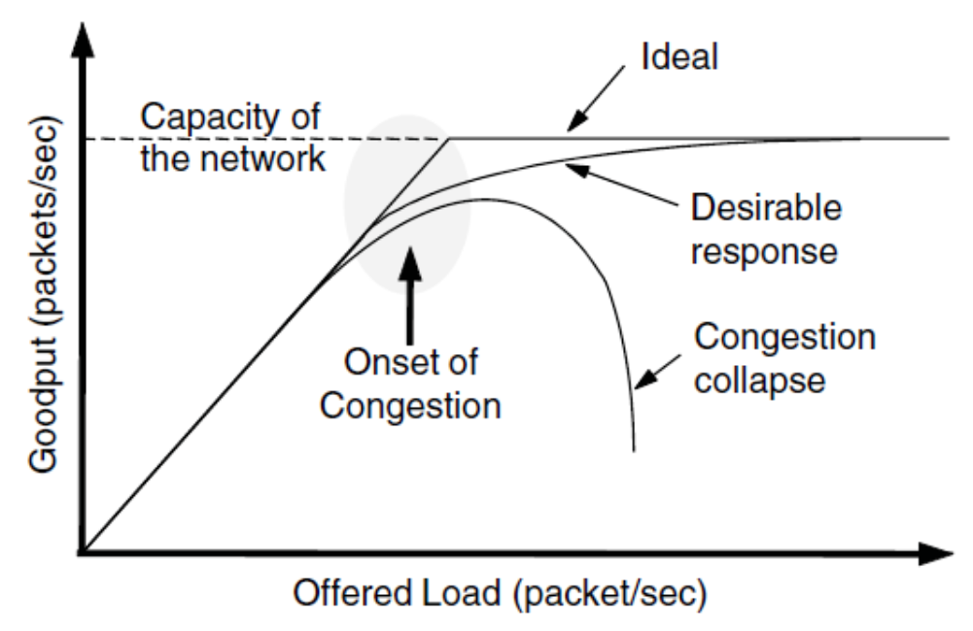
Congestion
Congestion occurs when the traffic flowing through a network exceeds its maximum capacity (OR) When too many packets are present in (a part of) the subnet, performance degrades. This situation is called Congestion
The network and transport layers share the responsibility for handling congestion
Since congestion occurs within the network, it is the network layer that directly experiences
It and must ultimately determine what to do with the excess packets.
However, the most effective way to control congestion is to reduce the load that the transport layer is placing on the network

Slide 4
Congestion (Contd.)
When the number of packets within its carrying capacity, they are all delivered
The number delivered is proportional to the number sent
As traffic increases too far, the routers are no longer able to cope and they begin losing packets
At very high traffic, performance collapses completely and almost no packets are delivered

Slide 5
Congestion (Contd.)
Factors Causing Congestion
Streams of packets begin arriving on three or four input lines and all need the same output line, a queue will build up
If there is insufficient memory to hold all of them, packets will be lost
Slow processors in routers can also cause congestion
Low-bandwidth lines can also cause congestion
Any frequently mismatch between parts of the system may result in congestion and this problem will persist until all the components are in balance

Slide 6
Congestion Control vs. Flow Control
Congestion Control
It has to do with making sure the subnet is able to carry the offered traffic
It involves the behavior of all the hosts, all the routers, the store-and-forwarding processing within the routers, and all the other factors that tend to diminish the carrying capacity of the subnet
Flow Control
In contrast, relates to the point-to-point traffic between a given sender and a given receiver
Its job is to make sure that a fast sender cannot continually transmit data faster than the receiver is able to absorb it
Flow control frequently involves some direct feedback from the receiver to the sender to tell the sender how things are doing at the other end

Slide 7
Congestion Control vs. Flow Control (Contd.)
For example: Consider a fiber optic network with a capacity of 1000 gigabits/ sec on which a supercomputer is trying to transfer a file to a personal computer at 1 Gbps
There is no congestion (the network itself is not in trouble)
Flow control is needed to force the supercomputer to stop frequently to give the personal computer a chance to breathe
Consider a store-and-forward network with 1-Mbps lines and 1000 large computers, half of which are trying to transfer files at 100 kbps to the other half.
The problem is not that of fast senders overpowering slow receivers, but that the total offered traffic exceeds what the network can handle.

Slide 8
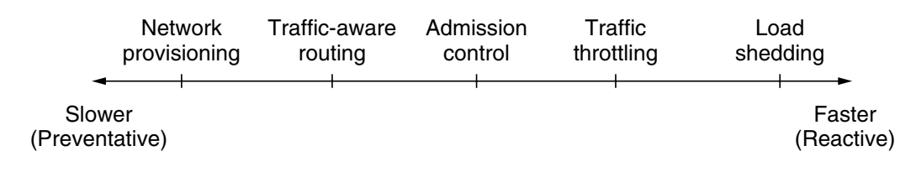
Approaches to Congestion Control
The presence of congestion means that the load is (temporarily) greater than the resources (in a part of the network) can handle
Two solutions: increase the resources or decrease the load
These solutions are usually applied on different time scales to either prevent congestion or react to it once it has occurred

Slide 9
Approaches to Congestion Control (Contd.)
Provisioning
The most basic way to avoid congestion is to build a network that is well matched to the traffic that it carries
The resources can be added dynamically when there is serious congestion
More often, links and routers that are regularly heavily utilized are upgraded at the earliest opportunity
Traffic Aware Routing
To make the most of the existing network capacity, routes can be tailored to traffic patterns that change during the day as network users wake and sleep in different time zones
Splitting traffic across multiple paths is one of the solution

Slide 10
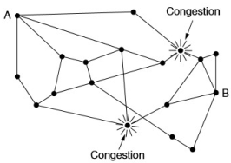
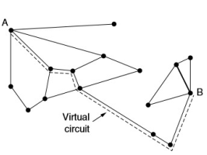
Approaches to Congestion Control (Contd.)
Admission Control
Sometimes it is not possible to increase capacity
The only way then to beat back the congestion is to decrease the load
In a virtual-circuit network, new connections can be refused if they would cause the network to become congested
Sending Feedback to the source to either slow down or to stop
Admission Control and Traffic aware Routing
Admission control can also be combined with traffic-aware routing by considering routes around traffic hotspots as part of the setup procedure

Slide 11
Approaches to Congestion Control (Contd.)
Traffic Throttling or Congestion Avoidance
Senders adjust their transmissions to send as much traffic as the network can readily deliver
The network aims to operate just before the onset of congestion
When congestion is coming up, it must tell the senders to throttle back (Slow Down the Sending of Data) their transmissions and slow down- Feedback
Traffic Throttling aims to solve two problems
Routers must determine when congestion is approaching, ideally before it has arrived
Routers must deliver timely feedback to the senders that are causing the congestion

Slide 12
Approaches to Congestion Control (Contd.)
Traffic Throttling or Congestion Avoidance
Traffic Throttling aims to solve two problems
Routers must determine when congestion is approaching, ideally before it has arrived
Each router can continuously monitor the resources it is using
The utilization of the output links
Buffering of queued packets inside the router
Number of packets that are lost due to insufficient buffering
Routers must deliver timely feedback to the senders that are causing the congestion
Requires action on behalf of the senders that are using the network
The router must identify the appropriate senders

Slide 13
Feedback Mechanisms
1. Choke Packets
Sending a warning bit is indirect way of telling the source to slow down
The choke packet mechanism is a node-level approach where a node stops sending packets when it reaches its buffer capacity, allowing other nodes to consume packets
In this approach, the router sends a choke packet back to the source host
The original packet is tagged (a header bit is turned on) so that it will not generate any more choke packets farther along the path and is then forwarded in the usual way
When the source host gets the choke packet, it is required to reduce the traffic
After certain interval the host listens for choke packets, if received it slows down its transmission still more
Typically, the first choke packet causes the data rate to be reduced to 0.50 of its previous rate, the next one causes a reduction to 0.25, and so on.
Increases are done in smaller increments to prevent congestion from reoccurring quickly

Slide 14
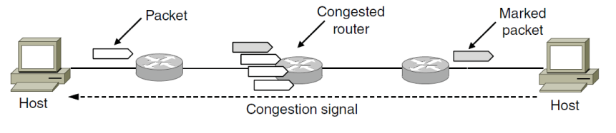
Feedback Mechanisms (Contd.)
2. Explicit Congestion Notification
Instead of generating additional packets to warn of congestion, a router can tag any packet it forwards (by setting a bit in the packet’s header) to signal that it is experience
This design is called ECN (Explicit Congestion Notification) and is used in the Internet
Two bits in the IP packet header are used to record whether the packet has experienced congestion
If any of the routers they pass through is congested, that router will then mark the packet as having experienced congestion as it is forwarded
The destination will then echo any marks back to the sender as an explicit congestion signal in its next reply packet

Slide 15
Feedback Mechanisms (Contd.)
Explicit Congestion Notification
This is shown with a dashed line in the figure to indicate that it happens above the IP level (e.g., in TCP)
The sender must then throttle its transmissions, as in the case of choke packet

Slide 16
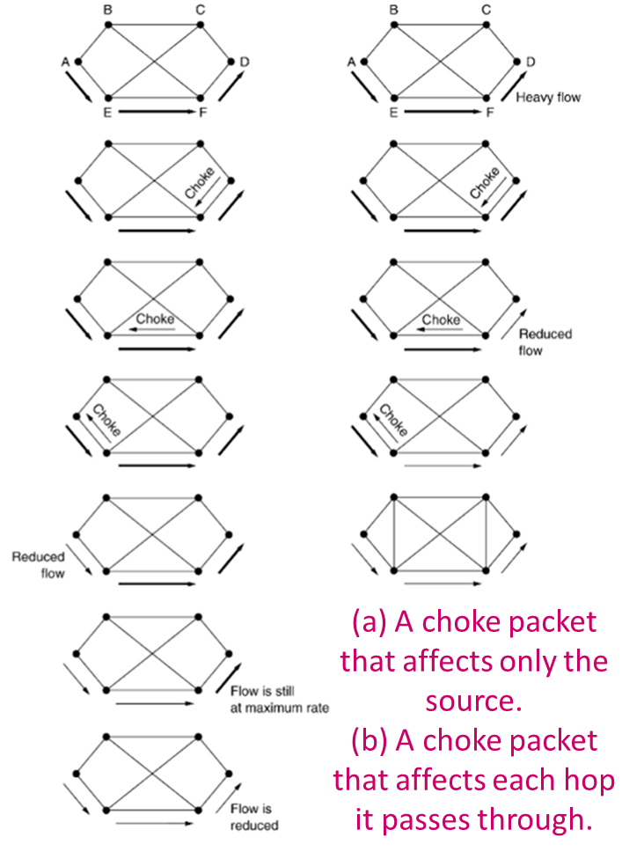
Feedback Mechanisms (Contd.)
3. Hop-by-Hop Backpressure
At high speeds or over long distances, sending a choke packet to the source hosts does not work well because the reaction is so slow
Hop-by-hop backpressure mechanism, on the other hand, is a link-level approach where each node reports back to its upstream node when its buffer is full, ensuring that traffic is slowed down at each hop to prevent buffer overflow.
An alternative approach is to have the choke packet take effect at every hop it passes through
The net effect of this hop-by-hop scheme is to provide quick relief at the point of congestion at the price of using up more buffers upstream

Slide 17
Feedback Mechanisms (Contd.)
3. Hop-by-Hop Backpressure
Consider an Example, a host in San Francisco (router A in Fig.) that is sending traffic to a host in New York (router D in Fig.) at the OC-3 speed of 155 Mbps
If the New York host begins to run out of buffers, it will take about 40 msec for a choke packet to get back to San Francisco to tell it to slow down

Slide 18
Feedback Mechanisms (Contd.)
Load Shedding
When none of the above methods make the congestion disappear : Load Shedding
The load shedding action is taken when routers are being starved by packets that they cannot handle, they just throw them away
A router can simply drop packets at random, but it could discard the packets depending on the applications running
For file transfer, an old packet is worth more than a new one, for multimedia, a new packet is more important than an old one
Intelligent discard policy- the packets must be marked as VERY IMPORTANT-NEVER, EVER DISCARD
Packets with Lower Priority, will be thrown out first
This is because dropping packet 6 and keeping packets 7 through 10, for example, will only force the receiver to do more work to buffer data that it cannot yet use

Slide 19
Feedback Mechanisms (Contd.)
1. Random Early Detection
Popular algorithm for doing this is called RED (Random Early Detection) (Floyd and Jacobson, 1993)
To determine when to start discarding, routers maintain a running average of their queue lengths
When the average queue length on some link exceeds a threshold, the link is said to be congested and a small fraction of the packets are dropped at random
Dealing with congestion when it first starts is more effective than letting it gum up the works and then trying to deal with it
This observation leads to an interesting twist on load shedding, which is to discard packets before all the buffer space is really exhausted
The affected sender will notice the loss when there is no acknowledgement, and then the transport protocol will slow down

Slide 20
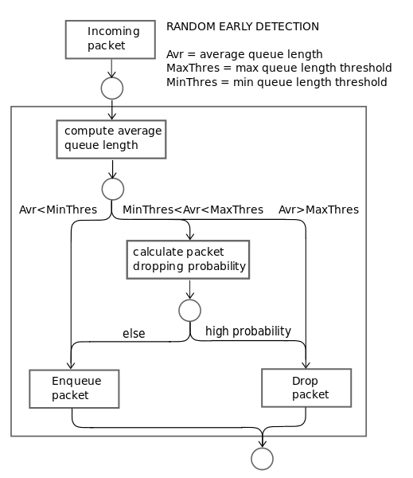
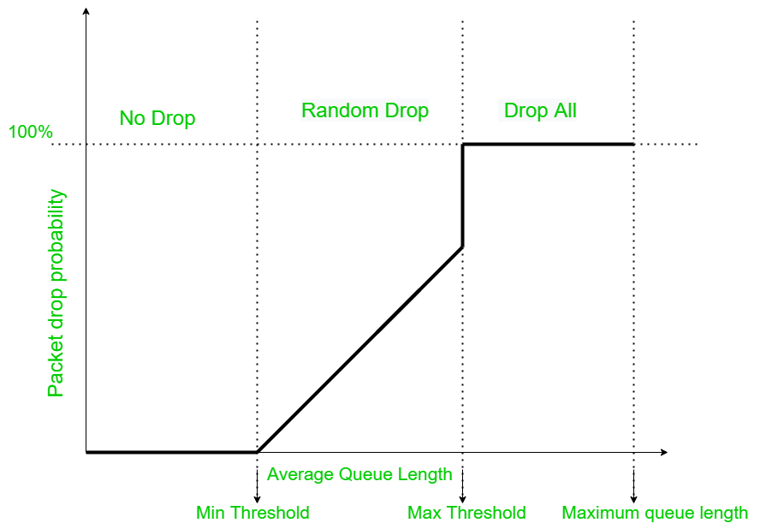
Feedback Mechanisms (Contd.)

Slide 21
Feedback Mechanisms (Contd.)
Congestion Control
Congestion Control
Virtual Circuit Subnet
Congestion Control
Datagram Subnet
No new Connection
Negotiation
Choke packets
Load shedding
Jitter control.

Slide 22
Quality of Service (QoS)
The techniques we looked at in the previous sections are designed to reduce congestion and improve network performance
However, there are applications (and customers) that demand stronger performance guarantees from the network
Example: Multimedia applications- need a high throughput and less latency
Here also will continue our study of network performance, but now with a sharper focus on ways to provide quality of service that is matched to application needs

Slide 23
QoS (Contd.)
Over-Provisioning
An easy solution to provide good quality of service is to build a network with enough capacity/ recourses
The resulting network will carry application traffic without significant loss and, assuming a decent routing scheme, will deliver packets with low latency
The trouble with this solution is that it is expensive
Quality of Service (QoS) mechanisms let a network with less capacity meet application requirements just as well at a lower cost

Slide 24
QoS (Contd.)
Four issues must be addressed to ensure quality of service:
What applications need from the network – Application Requirement
How to regulate the traffic that enters the network – Traffic Management/ Shaping
How to reserve resources at routers to guarantee performance – Resource Reservation
Whether the network can safely accept more traffic
No single technique deals efficiently with all these issues.
Instead, a variety of techniques have been developed for use at the network (and transport) layer
Practical quality-of-service solutions combine multiple techniques

Slide 25
QoS (Contd.)
Application Requirements
A stream of packets from a source to a destination is called a Flow
A flow might be all the packets of a connection in a connection-oriented network, or all the packets sent from one process to another process in a connectionless network
The needs of each flow can be characterized by Four Primary Parameters:
Bandwidth, Delay, Jitter, and Loss
Bandwidth : Maximum capacity of a wired or wireless communications link to transmit data over a network connection in a given amount of time
Delay : Amount of time taken by a packet to reach destination from the source
Jitter : Comparison drawn between the delivery of the packets
Loss : Occurs when a network packet fails to reach its expected destination, resulting in information loss
Together, these determine the QoS (Quality of Service) the flow requires

Slide 26
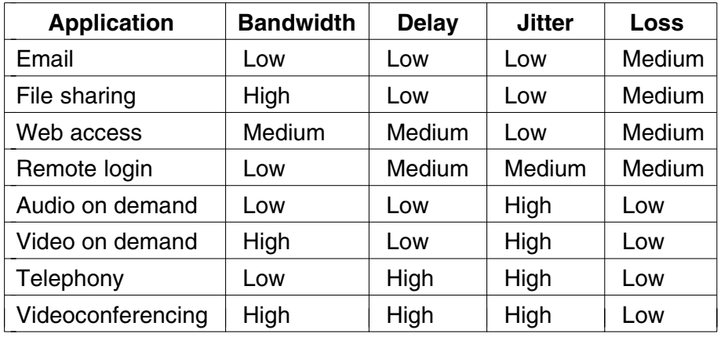
QoS (Contd.)
Application Requirements of Applications
To accommodate a variety of applications, networks may support different categories of QoS

Slide 27
Traffic Shaping
Traffic Shaping: Traffic shaping enables organizations to increase network performance by controlling the amount of data that flows into and out of the network
In the telephone network, this characterization is simple. For example, a voice call needs 64 kbps and consists of one 8-bit sample every 125 μsec
However, traffic in data networks is bursty. It typically arrives at nonuniform rates as the traffic rate varies, users interact with applications, and computers switch between tasks
Bursts of traffic are more difficult to handle
Traffic shaping is a technique for regulating the average rate and burstiness of a flow of data that enters the network
The of the Traffic shaping is to transmit a wide variety of traffic that suits their needs

Slide 28
Traffic Shaping
When a flow is set up, the user and the network (i.e., the customer and the provider) agree on a certain traffic pattern (i.e., shape) for that flow
This agreement is called an SLA (Service Level Agreement) when it is made over aggregate flows and long periods of time
Traffic shaping reduces congestion and thus helps the network live up to its promise
Packets in excess of the agreed pattern might be dropped by the network, or they might be marked as having lower priority
Monitoring a traffic flow is called traffic policing
Shaping and policing are not so important for peer-to-peer transfers, but they are of great importance for real-time data, such as audio and video connections, which have stringent quality-of-service requirements

Slide 29
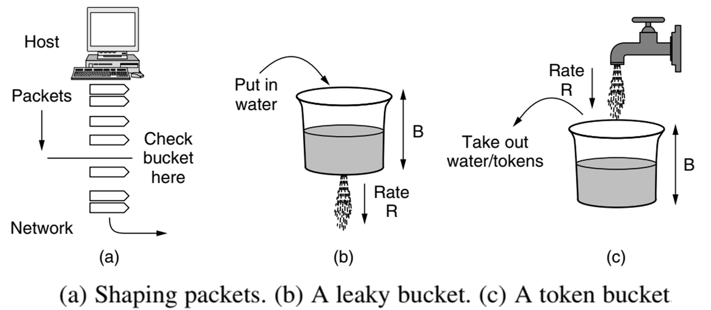
Traffic Shaping
Leaky and Token Buckets
Try to imagine a bucket with a small hole in the bottom, as illustrated in Fig b.
No matter the rate at which water enters the bucket, the outflow is at a constant rate, R, when there is any water in the bucket and zero when the bucket is empty
Also, once the bucket is full B, any additional water entering it spills over the sides and is lost

Slide 30
Traffic Shaping (Contd.)
Leaky and Token Buckets
This bucket can be used to shape or police packets entering the network, as shown in Fig b.
Conceptually, each host is connected to the network by an interface containing a leaky bucket.
To send a packet into the network, it must be possible to put more water into the bucket
If a packet arrives when the bucket is full, the packet must either be queued until enough water leaks out to hold it or be discarded
This technique was proposed by Turner (1986) and is called the leaky bucket algorithm
A different but equivalent formulation is to imagine the network interface as a bucket that is being filled, as shown in Fig. (c).
The tap is running at rate R and the bucket has a capacity of B, as before
Now, to send a packet we must be able to take water or tokens, as the contents are commonly called, out of the bucket (rather than putting water into the bucket). No more than a fixed number of tokens, B, can accumulate in the bucket, and if the bucket is empty, we must wait until more tokens arrive before we can send another packet

Slide 31
Traffic Shaping (Contd.)
Leaky Bucket Algorithm
Step - 1 : Initialize the counter to ‘n’ at every tick of clock.
Step - 2 : If n is greater than the size of packet in the front of queue send the packet into the network and decrement the counter by size of packet. Repeat the step until n is less than the size of packet.
Step - 3 : Reset the counter and go to Step – 1
Token Bucket Algorithm
Step - 1 : A token is added at every ∆t time.
Step - 2 : The bucket can hold at most b-tokens. If a token arrive when bucket is full it is discarded.
Step - 3 : When a packet of m bytes arrived m tokens are removed from the bucket and the packet is sent to the network.
Step – 4 : If less than m tokens are available no tokens are removed from the buckets and the packet is considered to be non conformant. The non conformant packet may be enqueued for subsequent transmission when sufficient token have been accumulated in the bucket.

Slide 32
Traffic Shaping (Contd.)
If B is the maximum capacity of bucket and R is the arrival rate and M is the maximum output rate then Burst Length S can be calculated as
MS = B + RS
This equates to S = B/(M- R)
Example: B=250KB, M=25MB/sec and R=2MB/sec S= 250/23= 11sec.

Slide 33
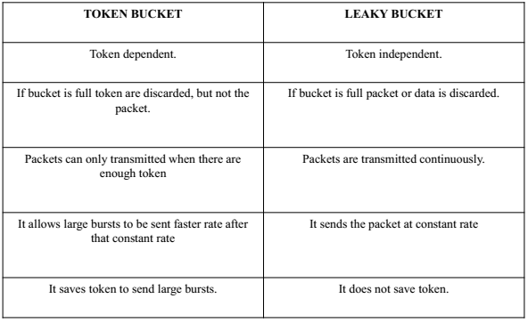
Traffic Shaping (Contd.)
Leaky Bucket Vs. Token Bucket

Slide 34
Traffic Shaping (Contd.)
Packet Scheduling
Algorithms that allocate router resources among the packets of a flow and between competing flows are called packet scheduling algorithms
Totally three different kinds of resources can potentially be reserved for different flows
1. Bandwidth
2. Buffer Space
3. CPU Cycles
Bandwidth Reservation
Making sure the bandwidth of input line and output line are fair enough to handle the traffic
For example: If a flow requires 1 Mbps and the outgoing line has a capacity of 2 Mbps, trying to direct three flows through that line is not going to work

Slide 35
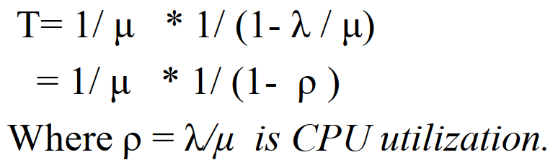
Traffic Shaping (Contd.)
Buffer Space
The packet is buffered inside router until it is transmitted
Purpose of buffer is to absorb small bursts of traffic
For good quality of service, some buffers might be reserved for a specific flow so that flow does not have to compete for buffers with other flows
CPU cycles
Routers CPU time is used to process a packet
Some kinds of packets require greater CPU processing, such as the ICMP packets
It should be made sure that the CPU is not overloaded to ensure timely processing of the packets
Computing CPU utilization :
Mean arrival rate of packets - λ packets/sec.
Mean processing capacity of packets- μ packets/sec
Delay experienced by a packet:

Slide 36
Traffic Shaping (Contd.)
For example,
if λ = 950,000 packets/sec μ = 1,000,000 packets/sec
ρ =0.95
Delay experienced by each packets: T= 20μsec instead of 1 μsec.
This time accounts for both the queueing time and the service time, as can be seen when the load is very low.
If there are, say, 30 routers along the flow's route, queueing delay alone will account for 600 μsec of delay

Slide 37
Packet Scheduling Algorithm
Packet scheduling algorithms allocate bandwidth and other router resources by determining which of the buffered packets to send on the output line next
FIFO (First In First Out) or FCFS (First Come First Serve)
Fair Queuing Algorithm
Weighted Fair Queuing

Slide 38
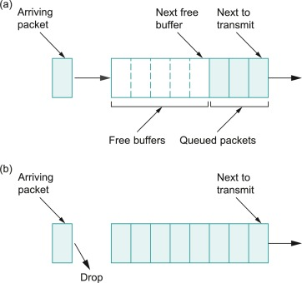
Packet Scheduling Algorithm (Contd.)
FIFO (First In First Out) or FCFS (First Come First Serve)
Each router buffers packets in a queue for each output line until they can be sent, and they are sent in the same order that they arrived
FCFS routers usually drop newly arriving packets when the queue is full– Tail Drop
FCFS scheduling is simple to implement, not suited for providing good QOS when there are multiple flows
If one of the flow is aggressive and send the packets very fast other flows will starve for the service

Slide 39
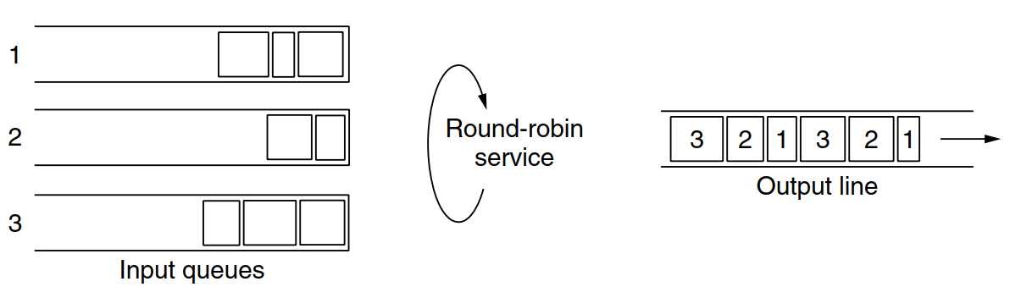
Packet Scheduling Algorithm (Contd.)
2. Fair Queuing Algorithm
The routers have separate queues, one for each flow for a given output line
The router scans the queues round-robin format
With ‘n’ hosts competing for the output line, each host gets to send one out of every n packets
It is fair in the sense that all flows get to send packets at the same rate
Drawback: more bandwidth is given to hosts that use large packets than to hosts that use small packets

Slide 40
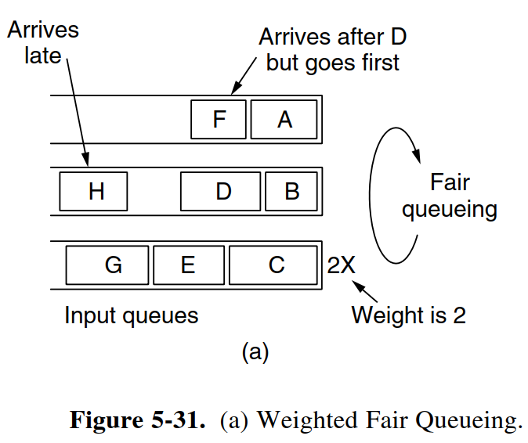
Packet Scheduling Algorithm (Contd.)
Use byte-by-byte round-robin, instead of a packet-by-packet round-robin
This algorithm gives same priority to all the hosts
To assign priority for some applications a variant of this algorithm Weighted Fair Queuing(WFQ) is used
Other scheduling algorithms – Round robin, priority scheduling

Slide 41
Admission Control
Admission Control is widely used in virtual-circuit networks to keep congestion at bay is admission control
The idea is simple: do not set up a new virtual circuit unless the network can carry the added traffic without becoming congested. Thus, attempts to set up a virtual circuit may fail
The network then decides whether to accept or reject the flow based on its capacity and the commitments it has made to other flows
If it accepts, the network reserves capacity in advance at routers to guarantee QoS when traffic is sent on the new flow
The reservations must be made at all of the routers along the route that the packets take through the network
QoS guarantees for new flows may still be accommodated by choosing a different route for the flow that has excess capacity. This is called QoS routing

Slide 42
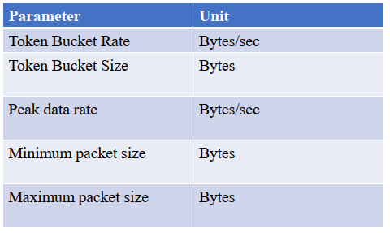
Admission Control (Contd.)
Flow specification- Describing a flow accurately in terms of specific parameters

Slide 43
Integrated Services
Between 1995 and 1997, IETF put a lot of effort into devising an architecture for streaming multimedia
This work resulted in over two dozen RFCs, starting with RFCs 2205–2212. The generic name for this work is integrated services
Architecture for streaming multimedia
Supports unicast and multicast applications
IntServ is an architecture that specifies the elements to guarantee quality of service (QoS) on networks
The IntServ approach involves the reservation of bandwidth on the network from end to end between two communicating devices, before communication begins
This is achieved using the Resource Reservation Protocol (RSVP)
Once the reservation is acquired, the communication takes place
When completed, the network resources are relinquished to be used by other applications and services
The routing algorithm is not part of RSVP

Slide 44
Integrated Services (Contd.)
The Resource reSerVation Protocol (RSVP)
RSVP allows multiple senders to transmit to multiple groups of receivers, permits individual receivers to switch channels freely, and optimizes bandwidth use while at the same time eliminating congestion
Each group is assigned a group address
To send to a group, a sender puts the group’s address in its packets
The standard multicast routing algorithm then builds a spanning tree covering all group members
The routing algorithm is not part of RSVP

Slide 45
Integrated Services (Contd.)
Consider a network, Hosts 1 and 2 are multicast senders, and hosts 3, 4, and 5 are multicast receivers
The multicast trees for hosts 1 and 2 are shown
The multicast trees for hosts 1 and 2 are shown in Fig. 5-34(b) and Fig. 5-34(c), respectively
To get better reception and eliminate congestion, any of the receivers in a group can send a reservation message up the tree to the sender
The message is propagated using the reverse path forwarding algorithm discussed earlier
At each hop, the router notes the reservation and reserves the necessary bandwidth
The Host 5 decides to watch the program being transmitted by host 1 and also makes a reservation
First, dedicated bandwidth is reserved as far as router H, later router sees that it already has a feed from host 1, so if the necessary bandwidth has already been reserved, it does not have to reserve any more.

Slide 46
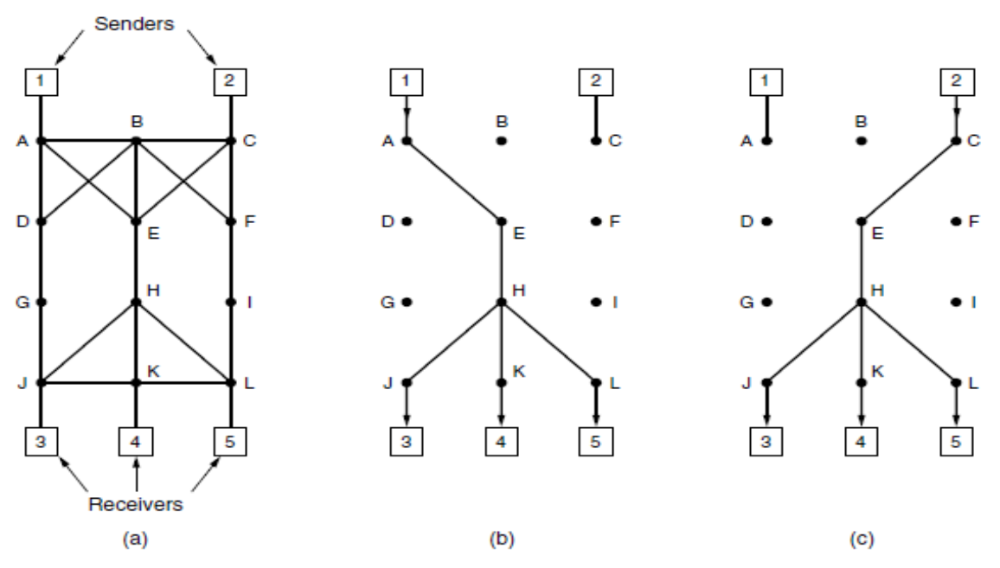
Integrated Services (Contd.)
Note that hosts 3 and 5 might have asked for different amounts of bandwidth (e.g., 3 has a small screen and 5 a bigger one with higher resolution).
The capacity reserved must be large enough to satisfy the greediest receiver

Slide 47
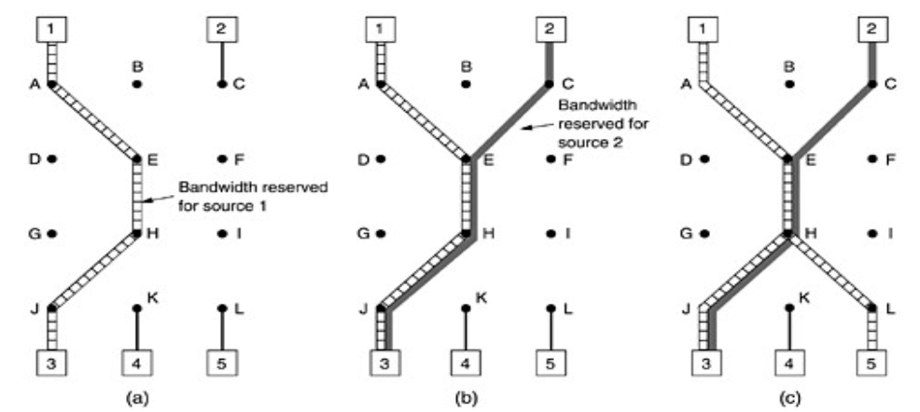
Integrated Services (Contd.)

Slide 48
Integrated Services (Contd.)
Drawbacks of IntServ
All routers within a network must be configured to support and respond to RSVP requests, if only one fails, the reservation will fail
There may potentially be hundreds or even thousands of individual reservation requests for routers to create, maintain and tear down reservations on demand, a process that can quickly overwhelm the CPU and memory of the RSVP-enabled routers
Because RSVP will reserve the bandwidth from end to end, no other service can use that bandwidth, even under conditions of extreme congestion

Slide 49
Differentiated Services
DiffServ is a QoS approach involving packet prioritization
With DiffServ, individual packets are marked according to the type of prioritization they require
The routers and switches use various queueing strategies to conform to these requirements
This approach is known as class-based (as opposed to flow-based) quality of service
Differentiated Services (DS) can be offered by a set of routers forming an administrative domain e.g. ISP
The administration defines a set of service classes with corresponding forwarding rules
If a customer signs up for DS, customer packets entering the domain may carry a Type of Service field in them, with better service provided to some classes (e.g., premium service) than to others
This scheme requires no advance setup, no resource reservation, and no time-consuming end-to-end negotiation for each flow, as with integrated services

Slide 50
Differentiated Services (Contd.)
Types of forwarding
Expedited forwarding
Assured Forwarding
Expedited Forwarding
The vast majority of the traffic is expected to be regular, but a limited fraction of the packets are expedited
The expedited packets should be able to transit the network as though no other packets were present
In this way they will get low loss, low delay and low jitter service—just what is needed for VoIP
Packets are classified as expedited or regular and marked accordingly.
This step might be done on the sending host or in the ingress (first) router
If the marking is done by the host, the ingress router is likely to police the traffic to make sure that customers are not sending more expedited traffic than they have paid for

Slide 51
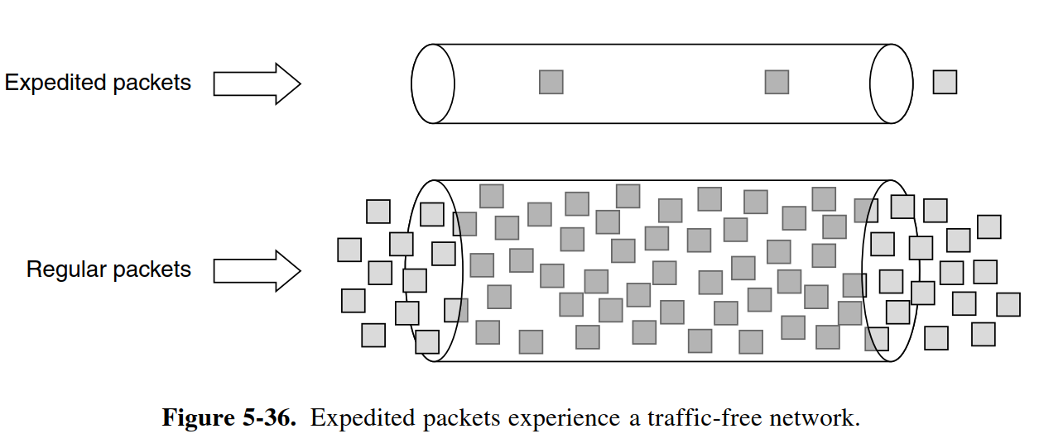
Differentiated Services (Contd.)
Within the network, the routers may have two output queues for each outgoing line, one for expedited packets and one for regular packets
When a packet arrives, it is queued accordingly
The expedited queue is given priority over the regular one, for example, by using a priority scheduler
In this way, expedited packets see an unloaded network, even when there is, in fact, a heavy load of regular traffic

Slide 52
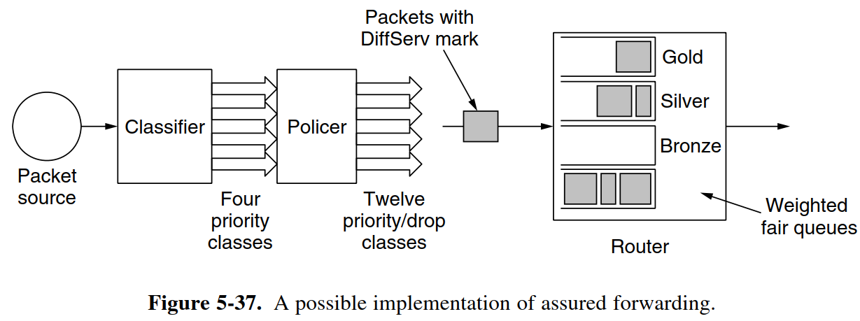
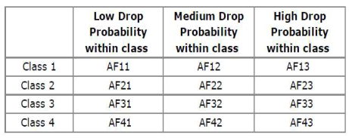
Differentiated Services (Contd.)
Assured Forwarding
Assured forwarding specifies that there shall be four priority classes, each class having its own resources
The top three classes might be called gold, silver, and bronze
In addition, it defines three discard classes for packets that are experiencing congestion: low, medium, and high
Taken together, these two factors define 12 service classes

Slide 53
Differentiated Services (Contd.)
The first step is to classify the packets into one of the four priority classes
The next step is to determine the discard class for each packet
Finally, the packets are processed by routers in the network with a packet scheduler that distinguishes the different classes
A common choice is to use weighted fair queueing for the four priority classes, with higher classes given higher weights
In this way, the higher classes will get most of the bandwidth, but the lower classes will not be starved of bandwidth entirely
For example, if the weights double from one class to the next higher class, the higher class will get twice the bandwidth. Within a priority class, packets with a higher discard class can be preferentially dropped by running an algorithm such as RED (Random Early Detection)

Slide 54
Integrated Vs. Differentiated Services
Parameters | Integrated Services | Differentiated Services
Network Type | Connection oriented | Connection less
Mechanism Used | Flow-based Mechanism | Class-based Mechanism
Signalling | Uses Explicit Signalling (RSVP) | No Explicit Signalling
Resource Reservation | Uses the Resource Reservation | No Reservation
QoS | End-to-End QoS | Hop-based QoS

Slide 55


